Slide 1

Foundation PHYSICS
Seminar 8: KIRCHOFF’S LAWs, RC CIRCUITS and MAGNETISM

Slide 2
Learning outcomes
Students will be able to :
Solve more complex electrical circuit problems by using Kirchhoff's Laws.
Solve problems related to charging and discharging a capacitor in the context of RC circuits.
Investigate the relationship between magnetic force and fields.

Slide 3
Practices Questions
Find the relation between the radius of the path of a charged particle in a magnetic field and its velocity (assume that the trajectory is perpendicular to the magnetic field).
You are given three identical resistors and a battery. Explain with reasoning: a) How would you arrange these resistors to get the MAXIMUM possible current from the battery? b) How would you arrange them to get the MINIMUM possible current? c) Why is the power dissipated by the battery different in these two cases even though it's the same battery?

Slide 4
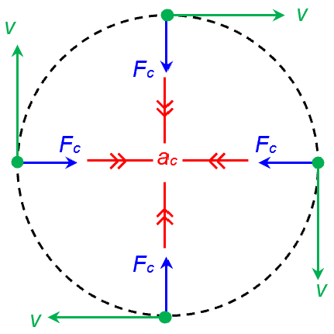
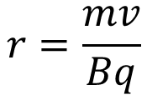
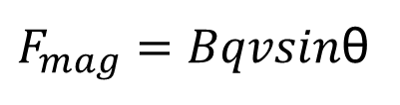
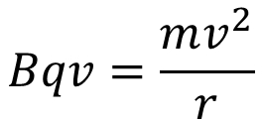
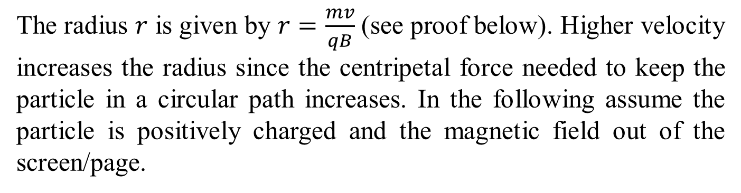

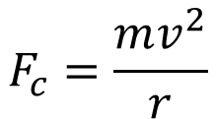

ANSWER: Practice Question 1
The radius $r$ is given by $r=\frac{mv}{qB}$ (see proof below). Higher velocity increases the radius since the centripetal force needed to keep the particle in a circular path increases. In the following assume the particle is positively charged and the magnetic field out of the screen/page.
$$F_{c}=\frac{mv^{2}}{r}$$
$F_{mag}=Bqvsin$θ
In figure above assume q$>$0 and B out the screen.
$$sin\text{θ}=\sin{90°}$$
$$Bqv=\frac{mv^{2}}{r}$$
$$r=\frac{mv}{Bq}$$

Slide 5

ANSWER: Practice Question 2
Series arrangement increases the overall resistance, while parallel arrangement decreases it.
Minimum current:
Connect all resistors in series
Current has only one path through all resistors
Equivalent resistance is 3R (more than any single resistor)
More total resistance means less current
$$R_{\text{eq}}=R_{1}+R_{2}+R_{3}$$

Slide 6
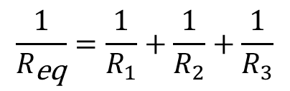
ANSWER: Practice Question 2
Series arrangement increases the overall resistance, while parallel arrangement decreases it.
Maximum current:
Connect all resistors in parallel
This creates multiple paths for current
Equivalent resistance is R/3 (less than any single resistor)
Less total resistance means more current (I = V/R)
$$\frac{1}{R_{\text{eq}}}=\frac{1}{R_{1}}+\frac{1}{R_{2}}+\frac{1}{R_{3}}$$
The overall resistance is smaller than the smallest resistor.

Slide 7
ANSWER: Practice Question 2
Power difference explanation:
Same battery voltage in both cases but different current
Power = VI, so different currents mean different powers
Parallel arrangement draws more current,
so battery depletes faster
Series arrangement draws less current, hence battery lasts longer

Slide 8
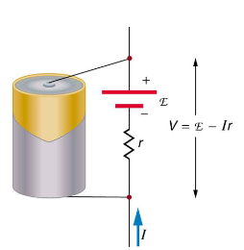
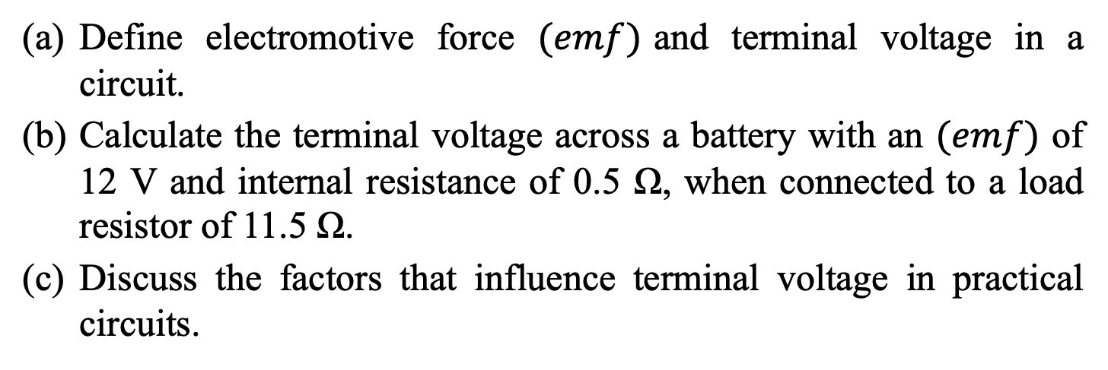
Question 1
Define electromotive force $(emf)$and terminal voltage in a circuit.
Calculate the terminal voltage across a battery with an $(emf)$ of 12 V and internal resistance of 0.5 Ω, when connected to a load resistor of 11.5 Ω.
Discuss the factors that influence terminal voltage in practical circuits.

Slide 9
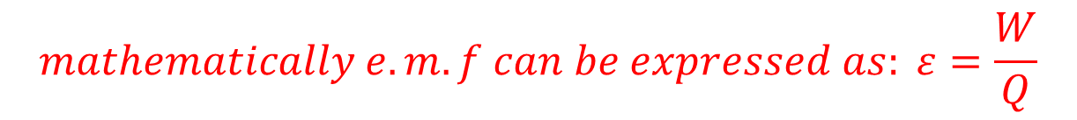
Question 1: ANSWERS
(a) electromotive force (𝑒𝑚𝑓) and terminal voltage
The electromotive force ε (or emf) is the energy provided by a cell or battery per coulomb of charge passing through it, it is measured in volts (V). It is equal to the potential difference across the terminals of the cell when no current is flowing.
$$mathematically e.m.f can be expressed as: ε=\frac{W}{Q}$$
Terminal voltage is the potential difference across the terminals of a load when the circuit is switched on.
$$terminal voltage can be expressed as: V_{t}=ε−Ir$$

Slide 10



Question 1: ANSWERS
(b) terminal voltage across a battery with an (𝑒𝑚𝑓)
Using $V=ε−Ir$, where $I=\frac{ε}{R+r}$:
$$I=\frac{12}{11.5+0.5}=1 \text{A}$$
$$V=12−1×0.5=11.5 \text{V}$$
(c) factors that influence terminal voltage
Terminal voltage can be influenced by the battery's internal resistance, the load resistance, and the current flowing through the circuit.

Slide 11
Question 2
A car battery with a 12 V emf and an internal resistance of 0.050Ω is being charged with a current of 60 A. Note that in this process the battery is being charged.
What is the potential difference across its terminals?
At what rate is thermal energy being dissipated in the battery?
At what rate is electric energy being converted to chemical energy?

Slide 12
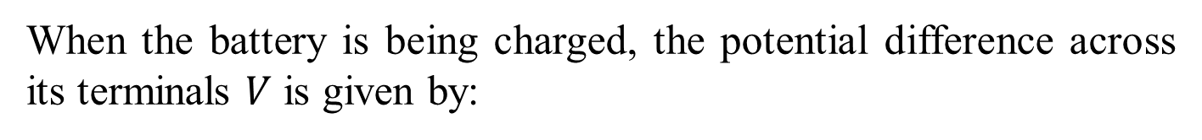

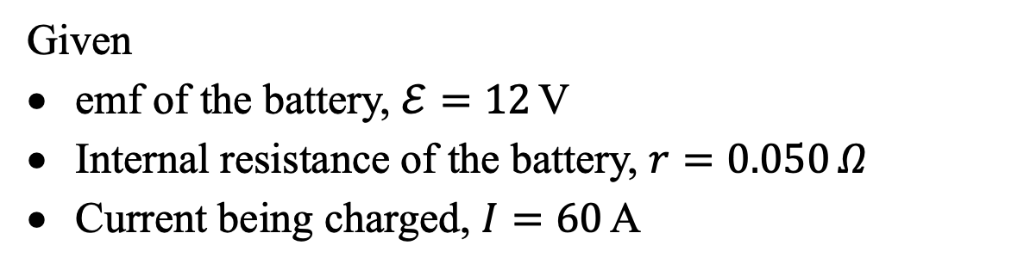



Question 2: ANSWERS
Given
emf of the battery, $ℰ=12$V
Internal resistance of the battery, $r=0.050 Ω$
Current being charged, $I=60$A
(a) Potential Difference Across the Terminals During Charging
When the battery is being charged, the potential difference across its terminals $V$ is given by:
$$V=ℰ+Ir$$
Substituting the given values:
$$V=12 \text{V}+\left(60 \text{A}×0.050 Ω\right)$$
$$V=12 \text{V}+3 \text{V}$$
$$V=15 \text{V}$$

Slide 13




Question 2: ANSWERS
(b) Rate of Thermal Energy Dissipation in the Battery
The rate of thermal energy dissipation in the battery, which is also the power lost due to the internal resistance, is given by:
$$P_{\text{thermal}}=I^{2}r$$
Substituting the given values:
$$P_{\text{thermal}}={\left(60 \text{A}\right)}^{2}×0.050 Ω$$
$$P_{\text{thermal}}=3600 {\text{A}}^{2}×0.050 Ω$$
$$P_{\text{thermal}}=180 \text{W}$$

Slide 14
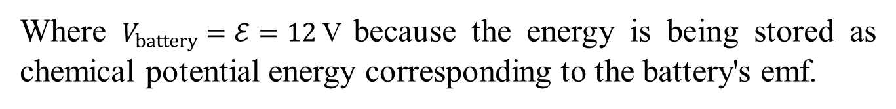



Question 2: ANSWERS
(c) Rate of Electric Energy Converted to Chemical Energy
The rate at which electric energy is being converted to chemical energy (which is effectively the power going into charging the battery) is given by:
$$P_{\text{chemical}}=IV_{\text{battery}}$$
Where $V_{battery}=ℰ=12$V because the energy is being stored as chemical potential energy corresponding to the battery's emf.
$$P_{\text{chemical}}=60 \text{A}×12 \text{V}$$
$$P_{\text{chemical}}=720 \text{W}$$

Slide 15
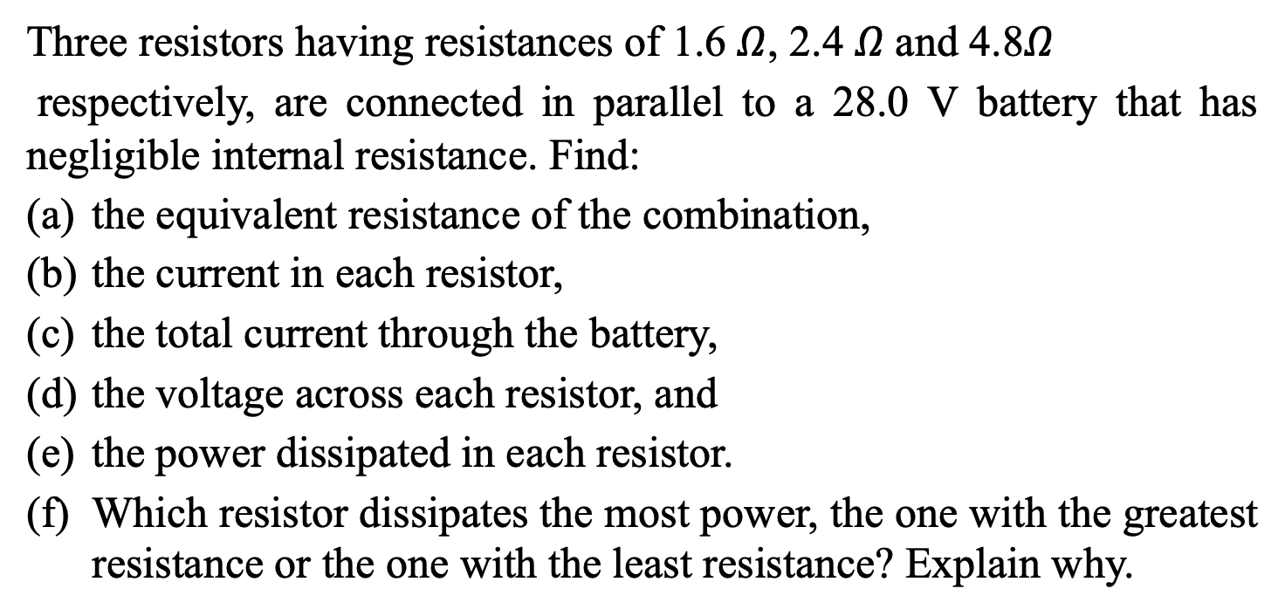
Question 3
Three resistors having resistances of 1.6 $Ω$, 2.4 $Ω$and 4.8$Ω$
respectively, are connected in parallel to a 28.0 V battery that has negligible internal resistance. Find:
the equivalent resistance of the combination,
the current in each resistor,
the total current through the battery,
the voltage across each resistor, and
the power dissipated in each resistor.
Which resistor dissipates the most power, the one with the greatest resistance or the one with the least resistance? Explain why.

Slide 16
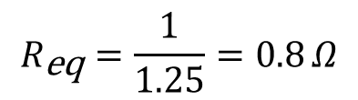
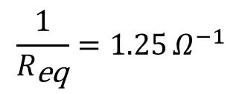
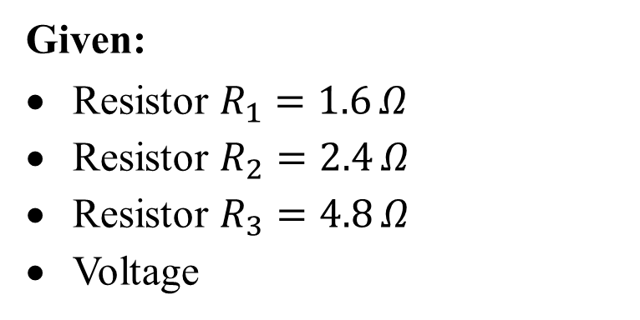
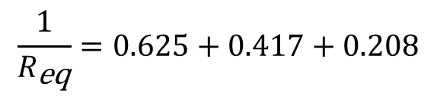
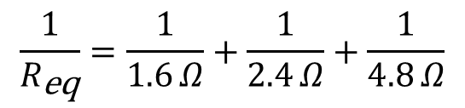
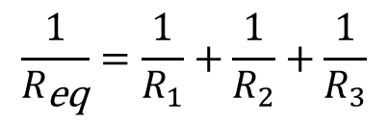
Question 3: ANSWERS
Given:
Resistor $R_{1}=1.6 Ω$
Resistor $R_{2}=2.4 Ω$
Resistor $R_{3}=4.8 Ω$
Voltage
(a) Equivalent Resistance of the Combination
For resistors in parallel, the equivalent resistance $R_{eq}$ is given by:
$$\frac{1}{R_{\text{eq}}}=\frac{1}{R_{1}}+\frac{1}{R_{2}}+\frac{1}{R_{3}}$$
Substitute the given resistances:
$$\frac{1}{R_{\text{eq}}}=\frac{1}{1.6 Ω}+\frac{1}{2.4 Ω}+\frac{1}{4.8 Ω}$$
$$\frac{1}{R_{\text{eq}}}=0.625+0.417+0.208$$
$$\frac{1}{R_{\text{eq}}}=1.25 Ω^{−1}$$
$$R_{\text{eq}}=\frac{1}{1.25}=0.8 Ω$$
So, the equivalent resistance is 0.8 Ω.

Slide 17
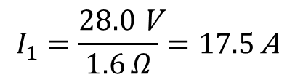

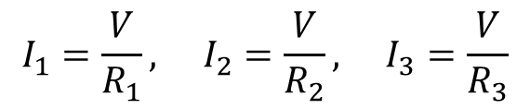
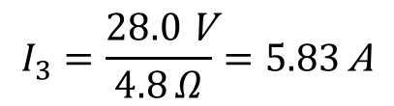
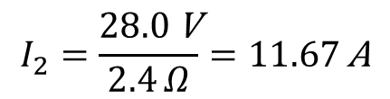
Question 3: ANSWERS
(b) Current in Each Resistor
The current through each resistor in a parallel circuit is given by Ohm's law:
$$I_{1}=\frac{V}{R_{1}}, I_{2}=\frac{V}{R_{2}}, I_{3}=\frac{V}{R_{3}}$$
Substitute the values:
$$I_{1}=\frac{28.0 \text{V}}{1.6 Ω}=17.5 \text{A}$$
$$I_{2}=\frac{28.0 \text{V}}{2.4 Ω}=11.67 \text{A}$$
$$I_{3}=\frac{28.0 \text{V}}{4.8 Ω}=5.83 \text{A}$$
So, the currents are $I_{1}=17.5$A, $I_{2}=11.67$A, and $I_{3}=5.83$A.
(c) Total Current Through the Battery
The total current through the battery is the sum of the currents through each resistor:
$$I_{\text{total}}=I_{1}+I_{2}+I_{3}$$
$$I_{\text{total}}=17.5 \text{A}+11.67 \text{A}+5.83 \text{A}=35.0 \text{A}$$
So, the total current through the battery is 35.0 A.

Slide 18
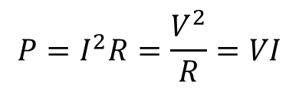
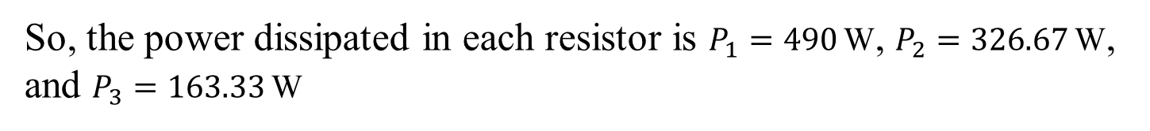

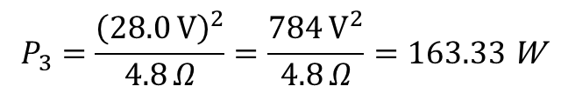
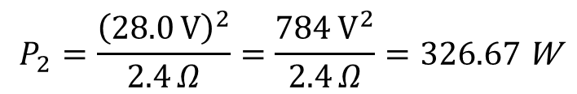
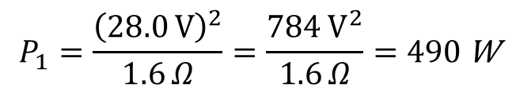
Question 3: ANSWERS
(d) Voltage Across Each Resistor
In a parallel circuit, the voltage across each resistor is the same as the voltage of the battery:
$$V_{1}=V_{2}=V_{3}=V=28.0 \text{V}$$
So, the voltage across each resistor is 28.0 V.
(e) Power Dissipated in Each Resistor
The power dissipated in each resistor is given by:
$$P=I^{2}R=\frac{V^{2}}{R}=VI$$
Substitute the values:
$$P_{1}=\frac{{\left(28.0 \text{V}\right)}^{2}}{1.6 Ω}=\frac{784 {\text{V}}^{2}}{1.6 Ω}=490 \text{W}$$
$$P_{2}=\frac{{\left(28.0 \text{V}\right)}^{2}}{2.4 Ω}=\frac{784 {\text{V}}^{2}}{2.4 Ω}=326.67 \text{W}$$
$$P_{3}=\frac{{\left(28.0 \text{V}\right)}^{2}}{4.8 Ω}=\frac{784 {\text{V}}^{2}}{4.8 Ω}=163.33 \text{W}$$
So, the power dissipated in each resistor is $P_{1}=490 \text{W}$, $P_{2}=326.67 \text{W}$, and $P_{3}=163.33 \text{W}$

Slide 19
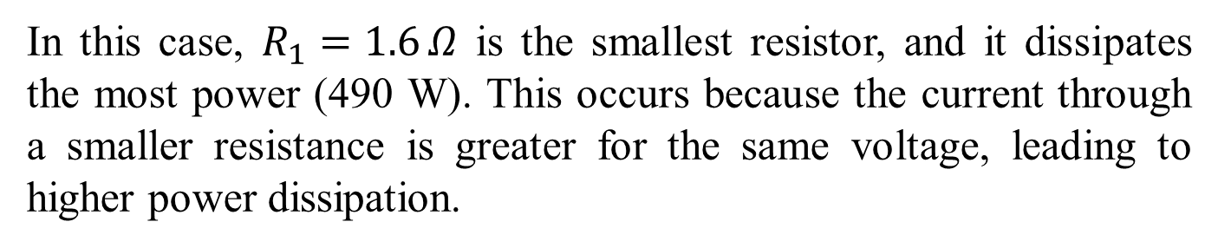
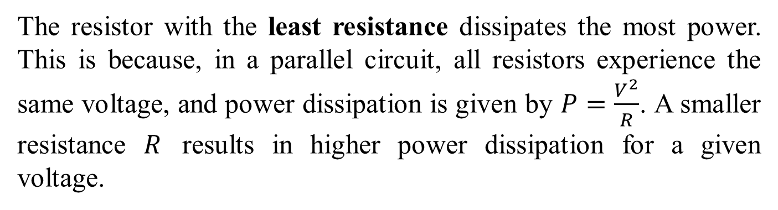
Question 3: ANSWERS
(f) Which Resistor Dissipates the Most Power?
The resistor with the least resistance dissipates the most power. This is because, in a parallel circuit, all resistors experience the same voltage, and power dissipation is given by $P=\frac{V^{2}}{R}$. A smaller resistance $R$ results in higher power dissipation for a given voltage.
In this case, $R_{1}=1.6 Ω$ is the smallest resistor, and it dissipates the most power (490 W). This occurs because the current through a smaller resistance is greater for the same voltage, leading to higher power dissipation.

Slide 20
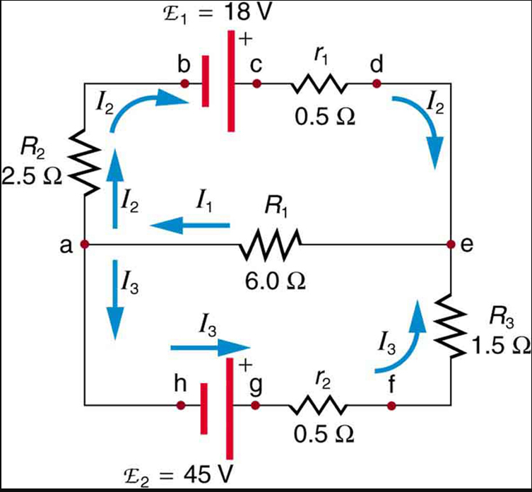
Question 4
What is Kirchhoff 1st and 2nd law?
Find the currents flowing in the circuit provided using Kirchhoff’s Rules.

Slide 21
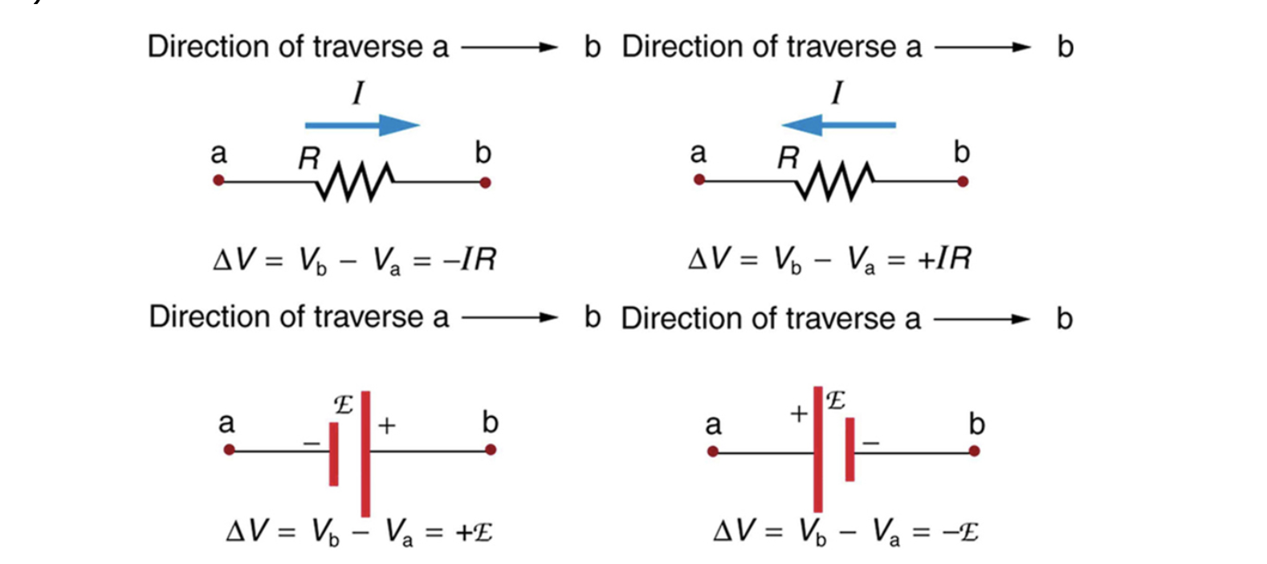
Question 4: ANSWERS
(a) What is Kirchhoff 1st and 2nd law?
Kirchhoff’s first law—the junction rule. The sum of all currents entering a junction must equal the sum of all currents leaving the junction.
Kirchhoff’s second law—the loop rule. The algebraic sum of changes in potential around any closed circuit path (loop) must be zero.

Slide 22

(b) Currents flowing in the circuit provided
By applying Kirchhoff’s first or junction law at point a. This gives:
$$I_{1}=I_{2}+I_{3} eq(1)$$

Slide 23








Question 4: ANSWERS
(b) Currents flowing in the circuit provided
By applying Kirchhoff’s second law or the loop rule. Considering loop abcdea.
$${−I}_{2}R_{2}+ε_{1}+{−I}_{2}r_{1}+{−I}_{1}R_{1}=0$$
$${−I}_{2}\left(R_{2}+r_{1}\right)+ε_{1}+{−I}_{1}R_{1}=0$$
$${−3I}_{2}+18{−6I}_{1}=0$$
$${−I}_{2}+6+{−2I}_{1}=0$$
$$→I_{2}=6{−2I}_{1} eq(2)$$
By applying the loop law to aefgha
$${+I}_{1}R_{1}+I_{3}R_{3}{+I}_{3}r_{2}−ε_{1}=0$$
$${+I}_{1}R_{1}+I_{3}\left(R_{3}+r_{2}\right)−ε_{1}=0$$
$${+6I}_{1}+{2I}_{3}−45=0$$
$$I_{3}=22.5{−3I}_{1} eq(3)$$

Slide 24











Question 4: ANSWERS
(b) Currents flowing in the circuit provided
$$I_{1}=I_{2}+I_{3} eq(1)$$
$$I_{2}=6{−2I}_{1} eq(2)$$
$$I_{3}=22.5{−3I}_{1} eq(3)$$
Substituting equations 2 and 3 into equation 1
$$I_{1}=I_{2}+I_{3} eq(1)$$
$$I_{1}=6{−2I}_{1}+22.5{−3I}_{1}$$
$${6I}_{1}=28.5$$
$$I_{1}=4.75 A$$
Substituting $I_{1}=4.75 A$ value for back into equations 2 and 3
$${eq\left(2\right): I}_{2}=6−2\left(4.75\right)→$$
$$I_{2}=−3.5 A$$
$$eq\left(3\right): I_{3}=22.5−3\left(4.75\right)→$$
$$I_{3}=8.25 A$$

Slide 25
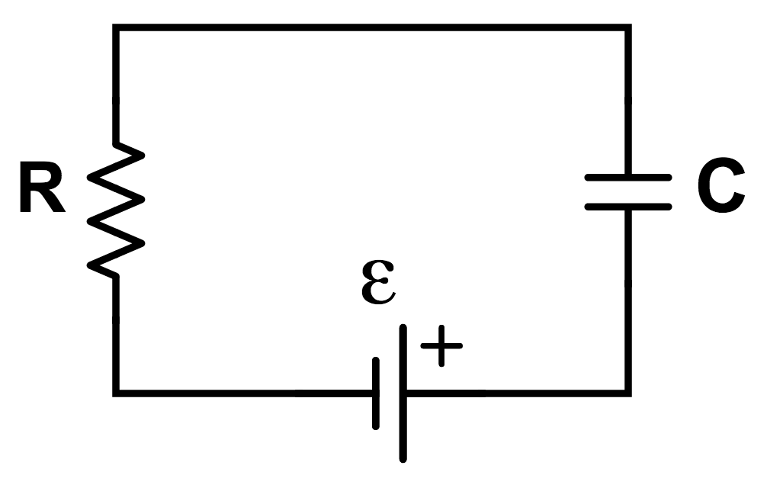
Question 5
Using the exact exponential treatment, determine how much time is required to charge an initially uncharged 100 nF capacitor through a 75.0 MΩ resistor to 90.0% of its final voltage in a RC circuit.

Slide 26
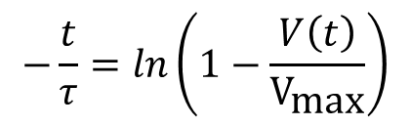
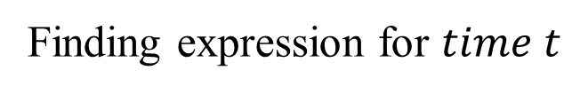
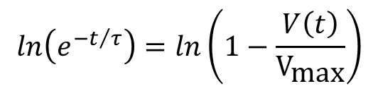
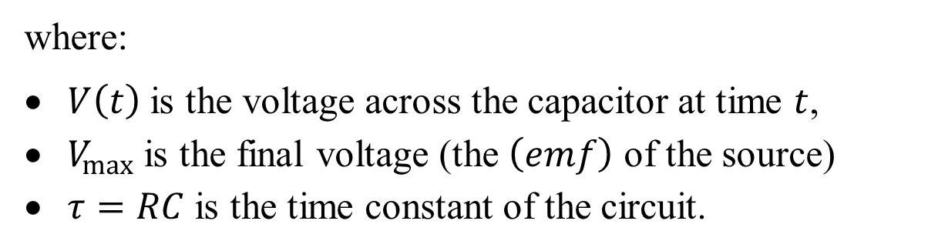
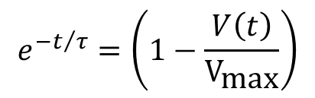
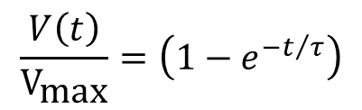
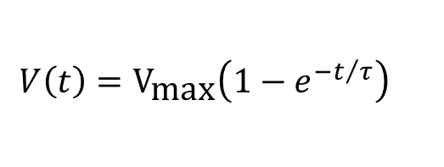
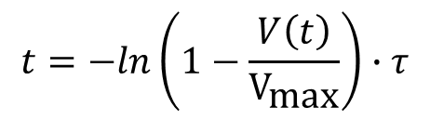
Question 5: ANSWERS
where:
$V\left(t\right)$ is the voltage across the capacitor at time $t$,
$V_{max}$ is the final voltage (the $\left(emf\right)$ of the source)
$τ=RC$ is the time constant of the circuit.
Finding expression for $time t$
$$ln\left(e^{−t/τ}\right)=ln\left(1−\frac{V\left(t\right)}{V_{\text{max}}}\right)$$
$$V\left(t\right)=V_{\text{max}}\left(1−e^{−t/τ}\right)$$
$$\frac{V\left(t\right)}{V_{\text{max}}}=\left(1−e^{−t/τ}\right)$$
$$−\frac{t}{τ}=ln\left(1−\frac{V\left(t\right)}{V_{\text{max}}}\right)$$
$$e^{−t/τ}=\left(1−\frac{V\left(t\right)}{V_{\text{max}}}\right)$$
$$t=−ln\left(1−\frac{V\left(t\right)}{V_{\text{max}}}\right)∙τ$$

Slide 27
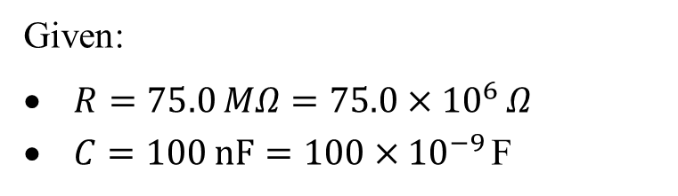

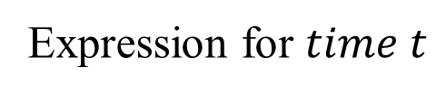
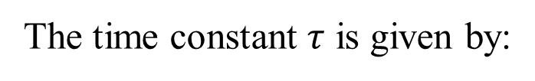

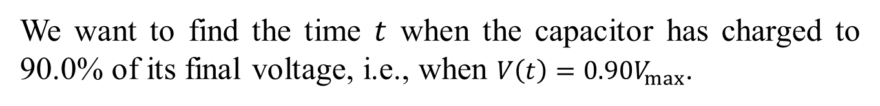

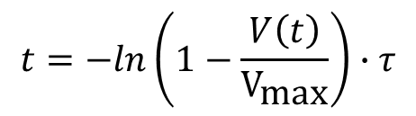
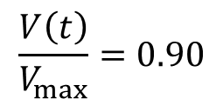

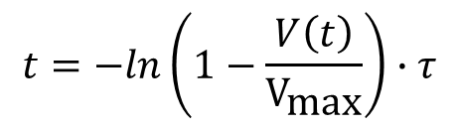


Question 5: ANSWERS
Expression for $time t$
$$t=−ln\left(1−\frac{V\left(t\right)}{V_{\text{max}}}\right)∙τ$$
The time constant $τ$ is given by:
$$τ=RC$$
Given:
$R=75.0 MΩ=75.0×{10}^{6} Ω$
$C=100 nF=100×{10}^{−9}$F
$$τ=75.0×{10}^{6} Ω×100×{10}^{−9} \text{F}$$
$$τ=7.50 \text{s}$$
We want to find the time $t$ when the capacitor has charged to 90.0% of its final voltage, i.e., when $V\left(t\right)=0.90V_{max}$.
$$\frac{V\left(t\right)}{V_{max}}=0.90$$
$$t=−ln\left(1−\frac{V\left(t\right)}{V_{\text{max}}}\right)∙τ$$
$$t=−ln\left(1−0.90\right)∙\left(7.50 \text{s}\right)$$
$$t=−ln\left(0.10\right)∙\left(7.50 \text{s}\right)$$
$$t=7.50 \text{s}×2.3026≈17.27 \text{s}$$
The time required to charge the 100 nF capacitor to 90.0% of its final voltage through a 75.0 MΩ resistor is approximately 17.27 seconds.

Slide 28
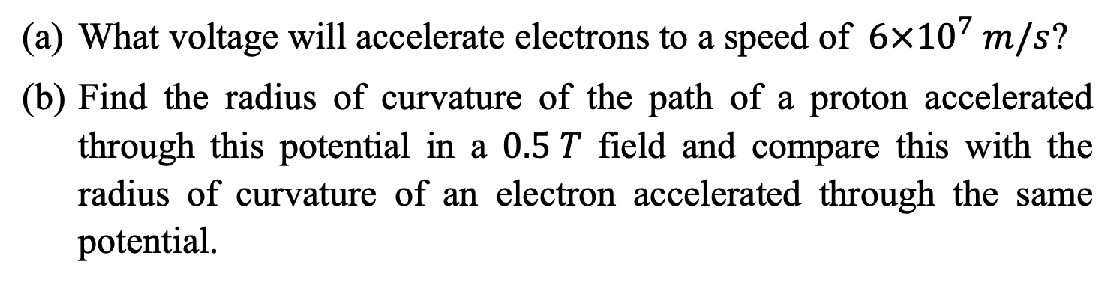
Question 6
What voltage will accelerate electrons to a speed of $6×{10}^{7} m/s$?
Find the radius of curvature of the path of a proton accelerated through this potential in a $0.5 T$ field and compare this with the radius of curvature of an electron accelerated through the same potential.

Slide 29



Question 6: ANSWERS
(a) Voltage to Accelerate Electrons to a Given Speed
where:
$m$ is the mass of the electron ($m_{e}=9.11×{10}^{−31}$kg),
$q_{e}$ is the charge of the electron ($q_{e}=1.60×{10}^{−19}$C),
$v$ is the speed of the electron,
$V$ is the potential difference (voltage).
To find the voltage required to accelerate electrons to a speed of $6×{10}^{7} m/s$, we use the energy principle where the kinetic energy of the electron is equal to the work done by the electric field:
$$\frac{1}{2}mv^{2}=q_{e}V$$

Slide 30






Question 6: ANSWERS
(a) Voltage to Accelerate Electrons to a Given Speed
Rearranging the equation to solve for $V$:
$$\frac{1}{2}mv^{2}=q_{e}V$$
$$V=\frac{1}{2}\frac{mv^{2}}{q_{e}}$$
Substitute the known values:
$$V=\frac{1}{2}\frac{\left(9.11×{10}^{−31} \text{kg}\right)×{\left(6.00×{10}^{7} \text{m}\text{/}\text{s}\right)}^{2}}{1.60×{10}^{−19} \text{C}}$$
$$V=\frac{1}{2}\frac{\left(9.11×{10}^{−31}\right)×\left(3.60×{10}^{15}\right)}{1.60×{10}^{−19}}$$
$$V=1.02x{10}^{4} \text{V}$$
So, the voltage required is approximately$1.02x{10}^{4}$V.

Slide 31





Question 6: ANSWERS
(b) Radius of Curvature of Proton and Electron in a Magnetic Field
The radius of curvature $r$ of a charged particle moving in a magnetic field is given by:
$$r=\frac{mv}{qB}$$
where:
$m$ is the mass of the particle,
$v$ is the velocity of the particle,
$q$ is the charge of the particle,
$B$ is the magnetic field strength.
For the Proton:
The proton is accelerated through the same potential $V$ found in part (a). Its speed $v_{p}$ is given by:
$$\frac{1}{2}m_{p}v_{p}^{2}=q_{e}V$$

Slide 32






Question 6: ANSWERS
(b) Radius of Curvature of Proton and Electron in a Magnetic Field
For the Proton:
The proton is accelerated through the same potential $V$ found in part (a). Its speed $v_{p}$ is given by:
$$v_{p}=\sqrt{\frac{2q_{e}V}{m_{p}}}$$
$$\frac{1}{2}m_{p}v_{p}^{2}=q_{e}V$$
Substitute $V=1.02×{10}^{4}$V, $m_{p}=1.67×{10}^{−27}$kg, and $q_{e} =1.60×{10}^{−19}$C:
$$v_{p}=\sqrt{\frac{2×1.60×{10}^{−19} \text{C}× 1.02x{10}^{4} \text{V}}{1.67×{10}^{−27} \text{kg}}}$$
Calculate $v_{p}$:
$$v_{p}=\sqrt{1.95×{10}^{12} \text{J}\text{/}\text{kg}}=1.4×{10}^{6} \text{m}\text{/}\text{s}$$

Slide 33





Question 6: ANSWERS
(b) Radius of Curvature of Proton and Electron in a Magnetic Field
For the Proton:
Now, calculate the radius of curvature for the proton:
$$r_{p}=\frac{m_{p}v_{p}}{q_{e}B}=\frac{\left(1.67×{10}^{−27} \text{kg}\right)×\left(1.4×{10}^{6} \text{m}\text{/}\text{s}\right)}{1.60×{10}^{−19} \text{C}×0.500 \text{T}}$$
$$r_{p}=2.92×{10}^{−2} \text{m}$$
For the Electron:
The speed $v_{e}$ of the electron is the same as calculated in part (a), $v_{e}=6.00×{10}^{7}$m/s.
Calculate the radius of curvature for the electron:
$$r_{e}=\frac{m_{e}v_{e}}{q_{e}B}=\frac{\left(9.11×{10}^{−31} \text{kg}\right)×\left(6.00×{10}^{7} \text{m}\text{/}\text{s}\right)}{1.60×{10}^{−19} \text{C}×0.500 \text{T}}$$
$$r_{e}=6.82×{10}^{−4} \text{m}$$

Slide 34

Question 6: ANSWERS
(b) Radius of Curvature of Proton and Electron in a Magnetic Field
The voltage required is approximately $1.02x{10}^{4}$V.
The radius of curvature for the proton is $2.9×{10}^{−2} \text{m}$, and for the electron, it is $6.82×{10}^{−4} \text{m}$.
The radius of curvature of the proton is larger than that of the electron. This is because the proton acquires greater momentum (mv) compared to that of an electron when both get accelerated by the same potential. Note that the proton and electron will be rotating in opposite directions as they have opposite charge.

Slide 35

Question 7
An electron moving at $4×103 m/s$ in a $1.25 T$ magnetic field experiences a magnetic force of $1.4× {10}^{−16} N$. What angle does the velocity of the electron make with the magnetic field? There are two answers.

Slide 36





Question 7: ANSWERS
To determine the angle between the velocity of the electron and the magnetic field, we can use the formula for the magnetic force on a charged particle:
$$F=qvBsinθ$$
where:
$F$ is the magnetic force,
$q$ is the charge of the electron ($q_{e}=1.60×{10}^{−19}$C),
$v$ is the velocity of the electron,
$B$ is the magnetic field strength,
$θ$ is the angle between the velocity and the magnetic field.
Rearrange the formula to solve for $θ$:
$$sinθ=\frac{F}{qvB}$$
Substitute the known values:
$$sinθ=\frac{1.40×{10}^{−16} \text{N}}{\left(1.60×{10}^{−19} \text{C}\right)×\left(4.00×{10}^{3} \text{m}\text{/}\text{s}\right)×\left(1.25 \text{T}\right)}$$

Slide 37






Question 7: ANSWERS
$$sinθ=\frac{1.40×{10}^{−16} \text{N}}{\left(1.60×{10}^{−19} \text{C}\right)×\left(4.00×{10}^{3} \text{m}\text{/}\text{s}\right)×\left(1.25 \text{T}\right)}$$
$$sinθ=\frac{1.40×{10}^{−16} \text{N}}{8.00×{10}^{−16} \text{N}}$$
$$sinθ=0.175$$
$$θ=arcsin\left(0.175\right)$$
$$θ≈{10.08}^{∘}$$
Since $sinθ$ is positive, the angle $θ$ can be:
$θ≈{10.08}^{∘}$
$θ≈{180}^{∘}−{10.08}^{∘}={169.92}^{∘}$

Slide 38


Question 8
Consider a capacitor C being discharged through a resistor R as shown in the figure. The initial potential difference across the capacitor is 3.0 V, the capacitance is 2.70×10⁻⁶ F, and the resistance is 1.80 $Ω$.
How long does it take for the charge on the capacitor to drop to one-fourth of its initial value?
Compute the initial charge and time constant.
How long does it take to discharge all but the last quantum of charge (1.60×10⁻¹⁹ C), if the initial potential difference across another capacitor is 12.0 V, the capacitance is equal to 3.50×10⁻⁶ F, and the resistance is 2.0 $Ω?$

Slide 39












Question 8
(a) How long does it take for the charge on the capacitor
$$Q\left(t\right)=Qe^{−\frac{t}{RC}}$$
$$\frac{1}{4}Q=Qe^{−\frac{t}{RC}}$$
$$\frac{1}{4}=e^{−\frac{t}{RC}}$$
$$t=−RCln\left(\frac{1}{4}\right)$$
$$t=−\left(1.80Ω\right)\left(2.70×{10}^{−6}\right)ln\left(\frac{1}{4}\right)$$
$t=6.74×{10}^{−6} s$
(b) Compute the initial charge and time constant
$$C=\frac{Q}{∆V}→Q=C∆V$$
$$Q=\left(2.70×{10}^{−6} F\right)\left(3 V\right)$$
$$Q=8.10×{10}^{−6}C$$
$$τ=RC$$
$$τ=\left(1.8\right)\left(2.70×{10}^{−6}\right)$$
$τ=$ $4.86×{10}^{−6} s$

Slide 40









Question 8
(c) How long does it take to discharge all but the last quantum of charge
$$C=\frac{Q}{∆V}→Q=C∆V$$
$$τ=RC=\left(2\right)\left(3.50×{10}^{−6}\right)$$
$$C=\left(3.50×{10}^{−6} F\right)\left(12 V\right)$$
$τ=7.0×{10}^{−6}$ $s$
$$C=4.2×{10}^{−5}C$$
$$Q\left(t\right)=Qe^{−\frac{t}{RC}}$$
$$1.60×{10}^{−19}=\left(4.2×{10}^{−5}\right)e^{−\frac{t}{7.0×{10}^{−6}}}$$
$$3.81×{10}^{−15}=e^{−\frac{t}{7.0×{10}^{−6}}}$$
$$t=−\left(7.0×{10}^{−6}\right)ln\left(3.81×{10}^{−25}\right)$$
$t=$ $2.32×{10}^{−4} s$

Slide 41
Q&A? Office hours:

Slide 42
Question 9 - Extension
A child’s electronic toy is supplied by three 1.58 V alkaline cells having internal resistances of 0.0200Ω in series with a 1.53 V carbon-zinc dry cell having a 0.100 Ω internal resistance. The load resistance is 10.0Ω.
Draw a circuit diagram of the toy and its batteries.
What current flows?
How much power is supplied to the load?
What is the internal resistance of the dry cell if it goes bad, resulting in only 0.500 W being supplied to the load?

Slide 43





Question 9: ANSWERS
(a) Draw a circuit diagram of the toy and its batteries
(b) What current flows
The 4 cells are connected in series, therefore $V_{total}=ε_{1}+ε_{2}+ε_{3}+ε_{4}$
and $R_{total}=r_{1}+r_{2}+r_{3}+r_{4}+R$
$$→I=\frac{V_{total}}{R_{total}}$$
$$I=\frac{3\left(1.58\right)+1.53}{3\left(0.02\right)+0.1+10}$$
$$I=0.617 A$$

Slide 44









Question 9: ANSWERS
(c) The power supplied to the load, $P_{Load}$
The power supplied to the load, $P_{Load}=I^{2}R$
$$P_{Load}={\left(0.617\right)}^{2}\left(10\right)$$
$$P_{Load}=3.81 W$$
(d) What is the internal resistance of the dry cell if it goes bad
Given $P_{Load}=I^{2}R=0.5$
$$→I=\sqrt{\frac{0.5}{10}}=0.2236 A$$
$$I=\frac{V_{total}}{R_{total}}=\frac{3\left(1.58\right)+1.53}{3\left(0.02\right)+r+10}=0.2236 A$$
$$0.2236\left(10.06+r\right)=6.27$$
$$→r=17.98 Ω$$

Slide 45


Question 10 - Extension
A network of five equal resistors $R$ is connected to a battery $ℰ$ as shown in the figure.
Determine the current $I$ that flows out of the battery.
(b) Use the value determined for I to find the single resistor $R_{eq}$ that is equivalent to the five-resistor network.

Slide 46













Question 10: ANSWERS
(a) Determine the current $I$ that flows out of the battery
Apply the junction rule
$$@ junction \left(a\right) I=I_{1}+I_{2} (1)$$
$$I_{1}$$
$${@ junction \left(b\right) I}_{2}=I_{3}+I_{4} (2)$$
a
$$I_{2}$$
b
$$I_{4}$$
c
$$I_{5}$$
d
$${@ junction \left(c\right) I}_{5}=I_{1}+I_{4} (3)$$
$@ junction \left(a\right) I=I_{3}+I_{5} (4)$
$$I_{3}$$
Apply the loop rule
$0=−I_{2}R−I_{4}R+I_{1}R (5)$
$$0=−I_{3}R+I_{5}R+I_{4}R (6)$$
$0=−I_{2}R−I_{3}R+ε (7)$

Slide 47









Question 10: ANSWERS
(a) Determine the current $I$ that flows out of the battery
Substitute eq(3) into eq(6)
Substitute eq(2) into eq(7)
$$0=−I_{3}R+\left(I_{1}+I_{4}\right)R+I_{4}R$$
$$0=−\left(I_{3}+I_{4}\right)R−I_{3}R+ε$$
$$0=−I_{3}R+I_{1}R+{2I}_{4}R (8)$$
$$0=−2I_{3}R−I_{4}R+ε (10)$$
Substitute eq(2) into eq(1)
Substitute eq(2) into eq(5)
$$I=I_{1}+\left(I_{3}+I_{4}\right)$$
$$0=−\left(I_{3}+I_{4}\right)R−I_{4}R+I_{1}R$$
$$I=I_{1}+I_{3}+I_{4} (9)$$
$$0=−I_{3}R−{2I}_{4}R+I_{1}R (11)$$

Slide 48









Question 10: ANSWERS
(a) Determine the current $I$ that flows out of the battery
From (8): $0=−I_{3}R+I_{1}R+{2I}_{4}R →{ I}_{4}=\frac{1}{2}I_{3}−\frac{1}{2}I_{1}$ (12)
From (11): $0=−I_{3}R−{2I}_{4}R+I_{1}R →{ I}_{4}=−\frac{1}{2}I_{3}+\frac{1}{2}I_{1} (13)$
Substitute (12) in (11): $0=−I_{3}R−{2I}_{4}R+I_{1}R$
$0=−I_{3}R−2\left(\frac{1}{2}I_{3}−\frac{1}{2}I_{1}\right)R+I_{1}R=−2I_{3}+2I_{1}→I_{3}=I_{1}$ (14)
Substitute (13) in (9): $I=I_{1}+I_{3}+I_{4}$
$I=I_{1}+I_{3}−\frac{1}{2}I_{3}+\frac{1}{2}I_{1} →I=$ $\frac{1}{2}I_{3}+\frac{3}{2}I_{1}$ (15)
Substitute (14) in (15):
$→I=$ $\frac{1}{2}I_{1}+\frac{3}{2}I_{1}=$ $2I_{1}$
Substitute (12) in (10):$0=−2I_{3}R−I_{4}R+ε$
$$0=−2I_{3}R−\left(−\frac{1}{2}I_{3}+\frac{1}{2}I_{1}\right)R+ε$$
$0=−\frac{3}{2}I_{3}R−\frac{1}{2}I_{1}R+$ $ε$
$0=−2I_{1}R+$ $ε$
$$R=\frac{ε}{2I_{1}}=\frac{ε}{I}→$$
$$I=\frac{ε}{R}$$

Slide 49



Question 10: ANSWERS
(b) single resistor $R_{eq}$ that is equivalent to the five-resistor network
$$R_{eq}=\frac{ε}{I}$$
where
$$I=\frac{ε}{R}$$
therefore
$$R_{eq}=\frac{ε}{\left(\frac{ε}{R}\right)}=R$$

